Slide 1

Computer Blue
The Music of Prince in the 80s

Slide 2
Introduction
Jamie Wheeler
Prince fan since the mid 80s.
Saurabh Rao
Prince fan since Saturday.

Slide 3
The Proposal
Investigate music artist, Rogers Prince Nelson, also known as Prince.
Statistical and visual analysis of his music, lyrics, and objective metrics.
Attempt to identify patterns and critical factors in his music
We chose Prince due to the varying nature of his songs sentiments.

Slide 4
The Data
NAME | TYPE
Song Name | String
Album Name | String
Position on Album | Integer
In Hot 100 Billboard | Categorical
Position | Integer
Year | Integer
Song length in seconds | Integer
BPM Value | Integer
Key | String
Sentiment | Integer
Category | Categorical
Word Count | Integer
Lyrics | String
i scraped his lyrics
created a sentiment index by matching it known indexes
then created a relative sentiment per song
then gathered data like bpm, word count, song length
chart position
album info
and created models to see what could be predicted
ed his lyrics
created a sentiment index by matching it known indexes
then created a relative sentiment per song
then gathered data like bpm, word count, song length
chart position
album info
and created models to see what could be predicted

Slide 5
Data gathering - Sources and Methods
VARIABLE | TOOL/LANGUAGE USED | PROCESS
Song Name, Album Name, Position on Album | Import.io | Wikipedia each album ; extract using import.io
In Top 100 Billboard , Position | Microsoft Excel | Import using import.io ; Position in Top 100 if in list.
Song Length | Python | Extract using urllib2 & lxml, convert from min to sec .
BPM Values | Import.io , Manual | Used import.io for 3 albums , rest manually.
Key | None | Manually
Sentiment | R | Compared lyrics with a set of +,- words
Lyrics | Import.io | Lyrics from princelyrics.co.uk . Scraped using import.io

Slide 6
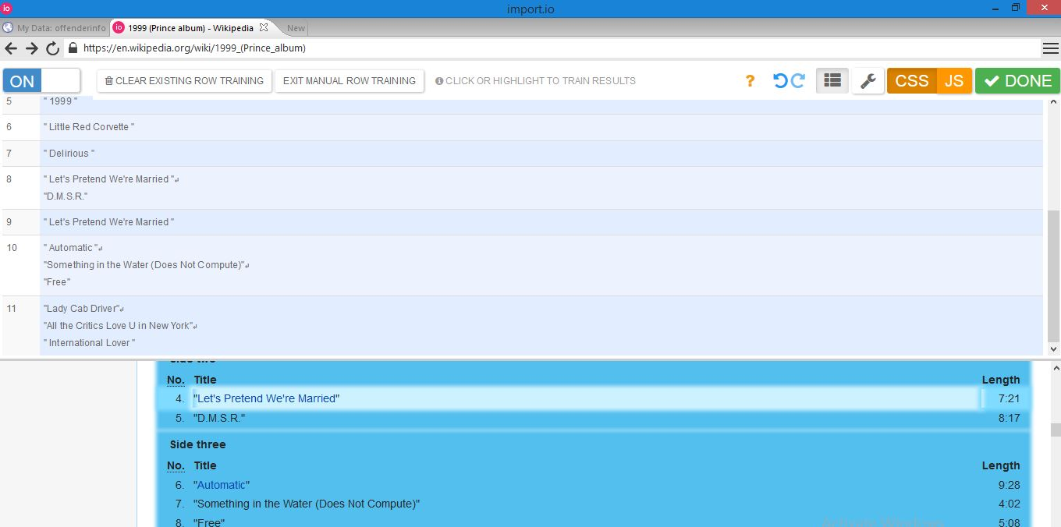

Slide 7
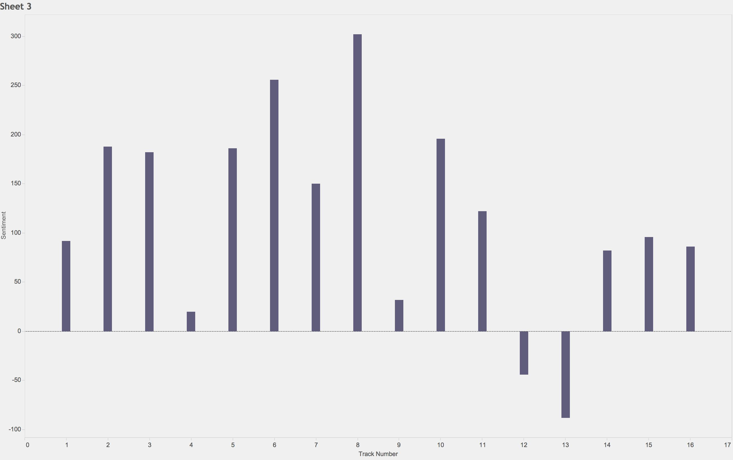
Total Sentiment by Track

Slide 8
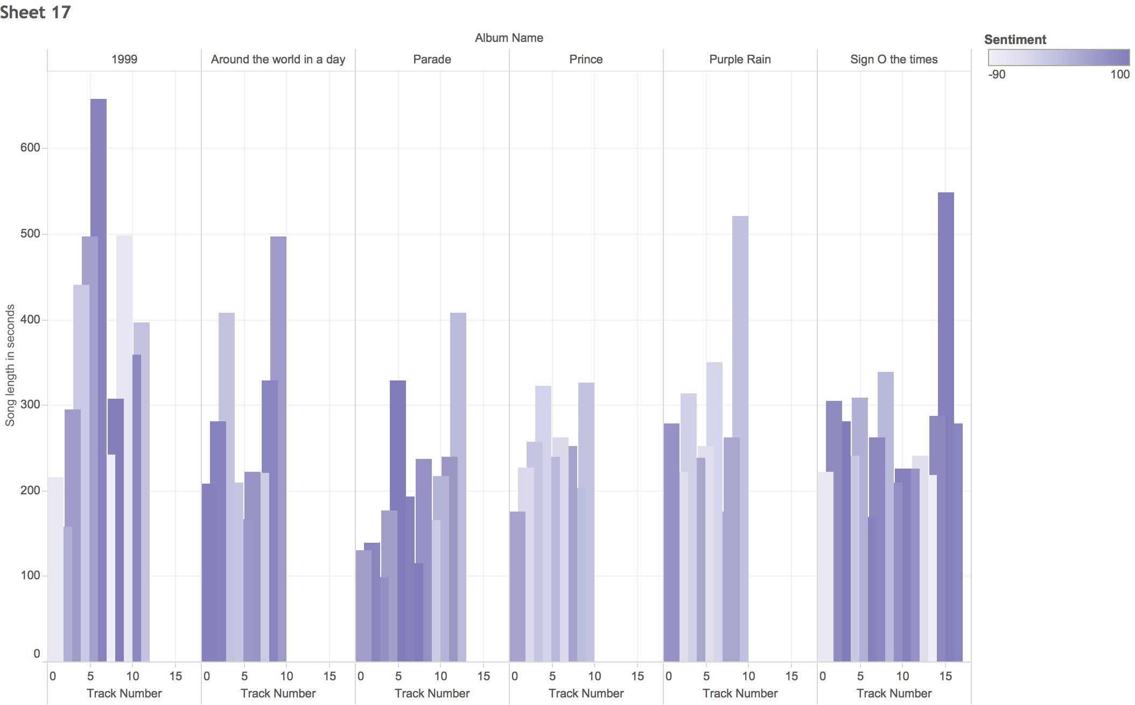
Sentiment by Track and Album

Slide 9
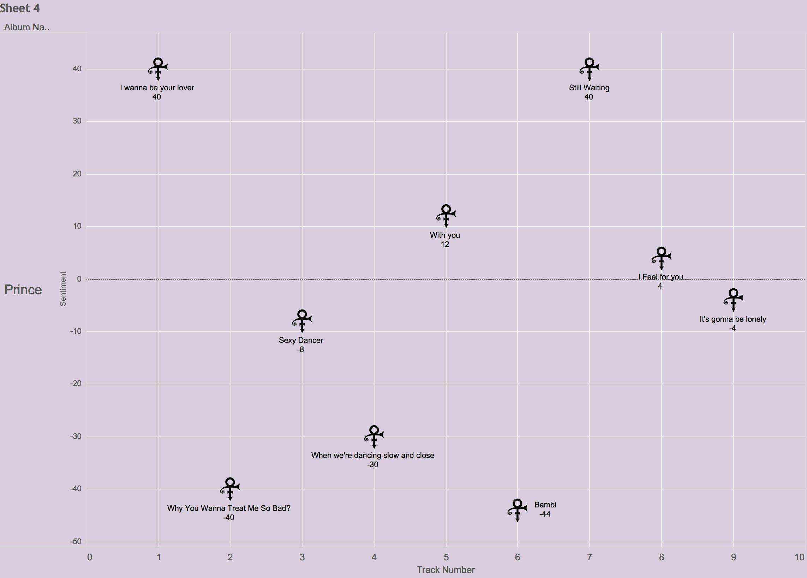
Sentiment by Track - Prince

Slide 10
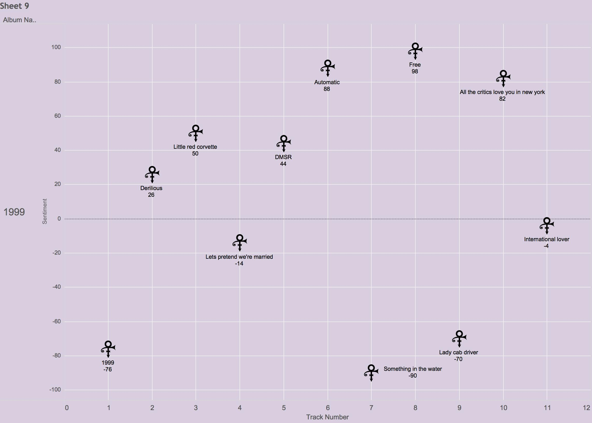
Sentiment by Track - 1999

Slide 11
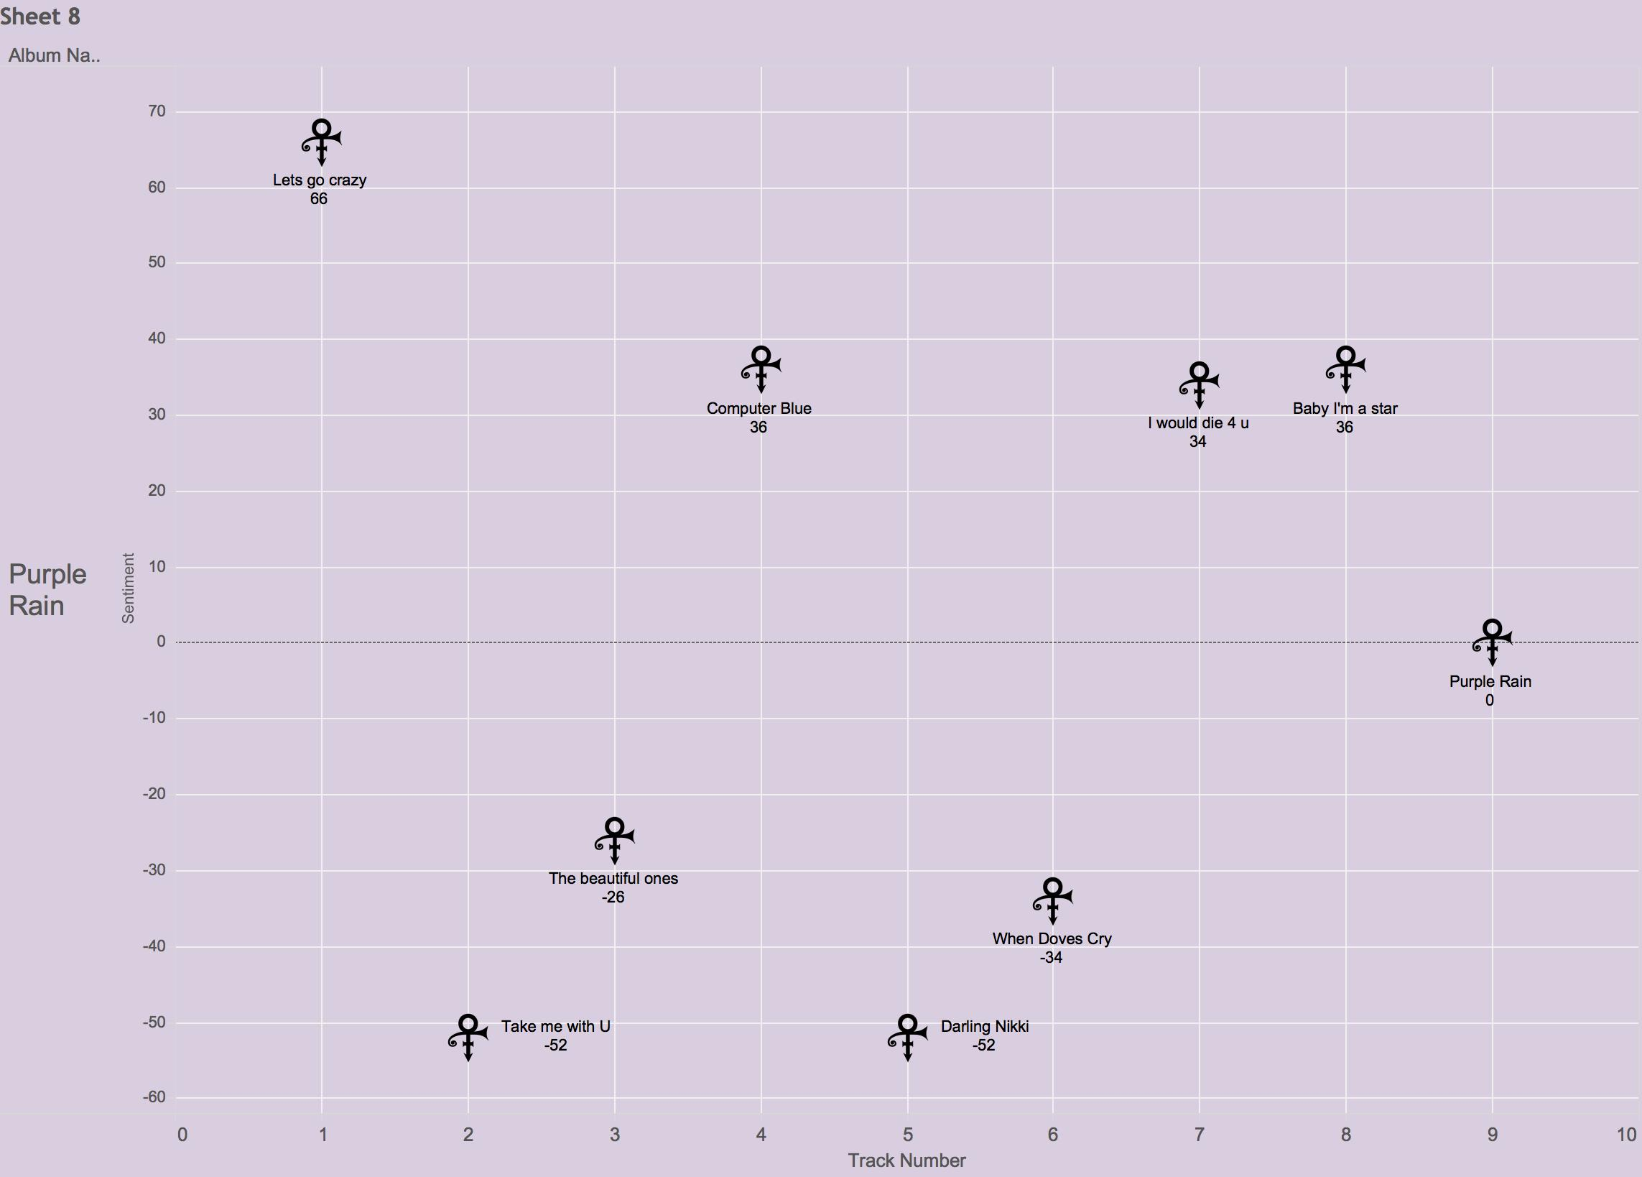
Sentiment by Track – Purple Rain

Slide 12
The Neutral Purple Rain
I never meant to cause you any sorrow I never meant to cause you any pain I only wanted to one time to see you laughing I only wanted to see you Laughing in the purple rain
[Chorus]
I never wanted to be your weekend lover I only wanted to be some kind of friend Baby, I could never steal you from another It's such a shame our friendship had to end
Positive Sentiment Word
Negative Sentiment Word
-sorrow + -pain + laughing + Laughing + lover + friend + -steal + -shame =
-1-1+1+1+1+1-1-1 = 0

Slide 13
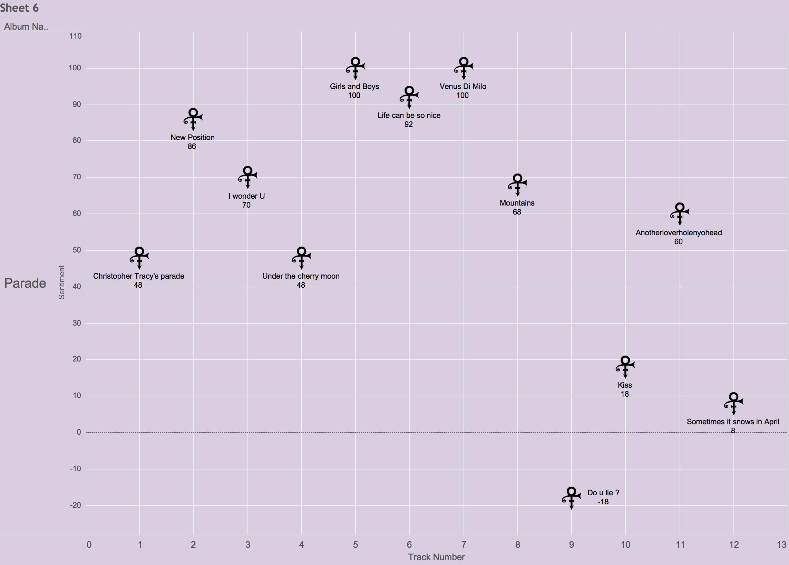
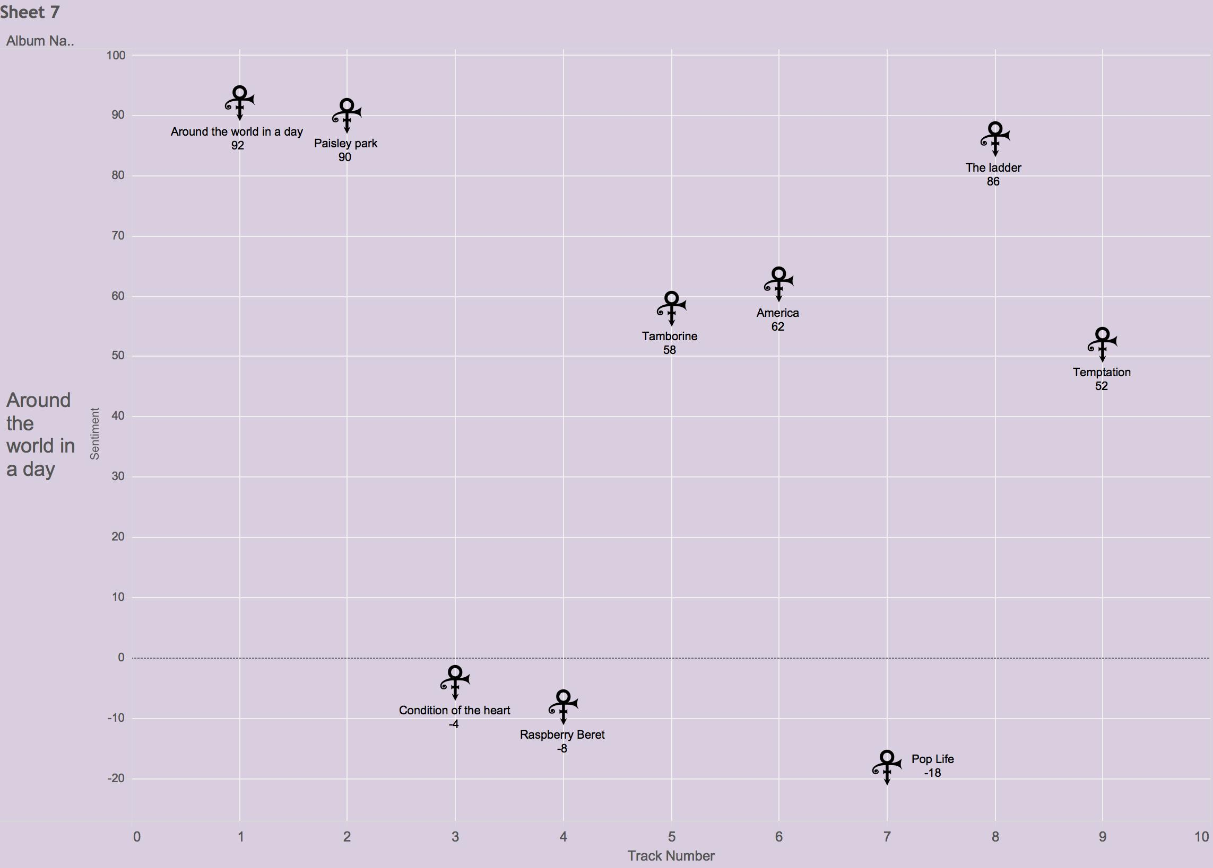
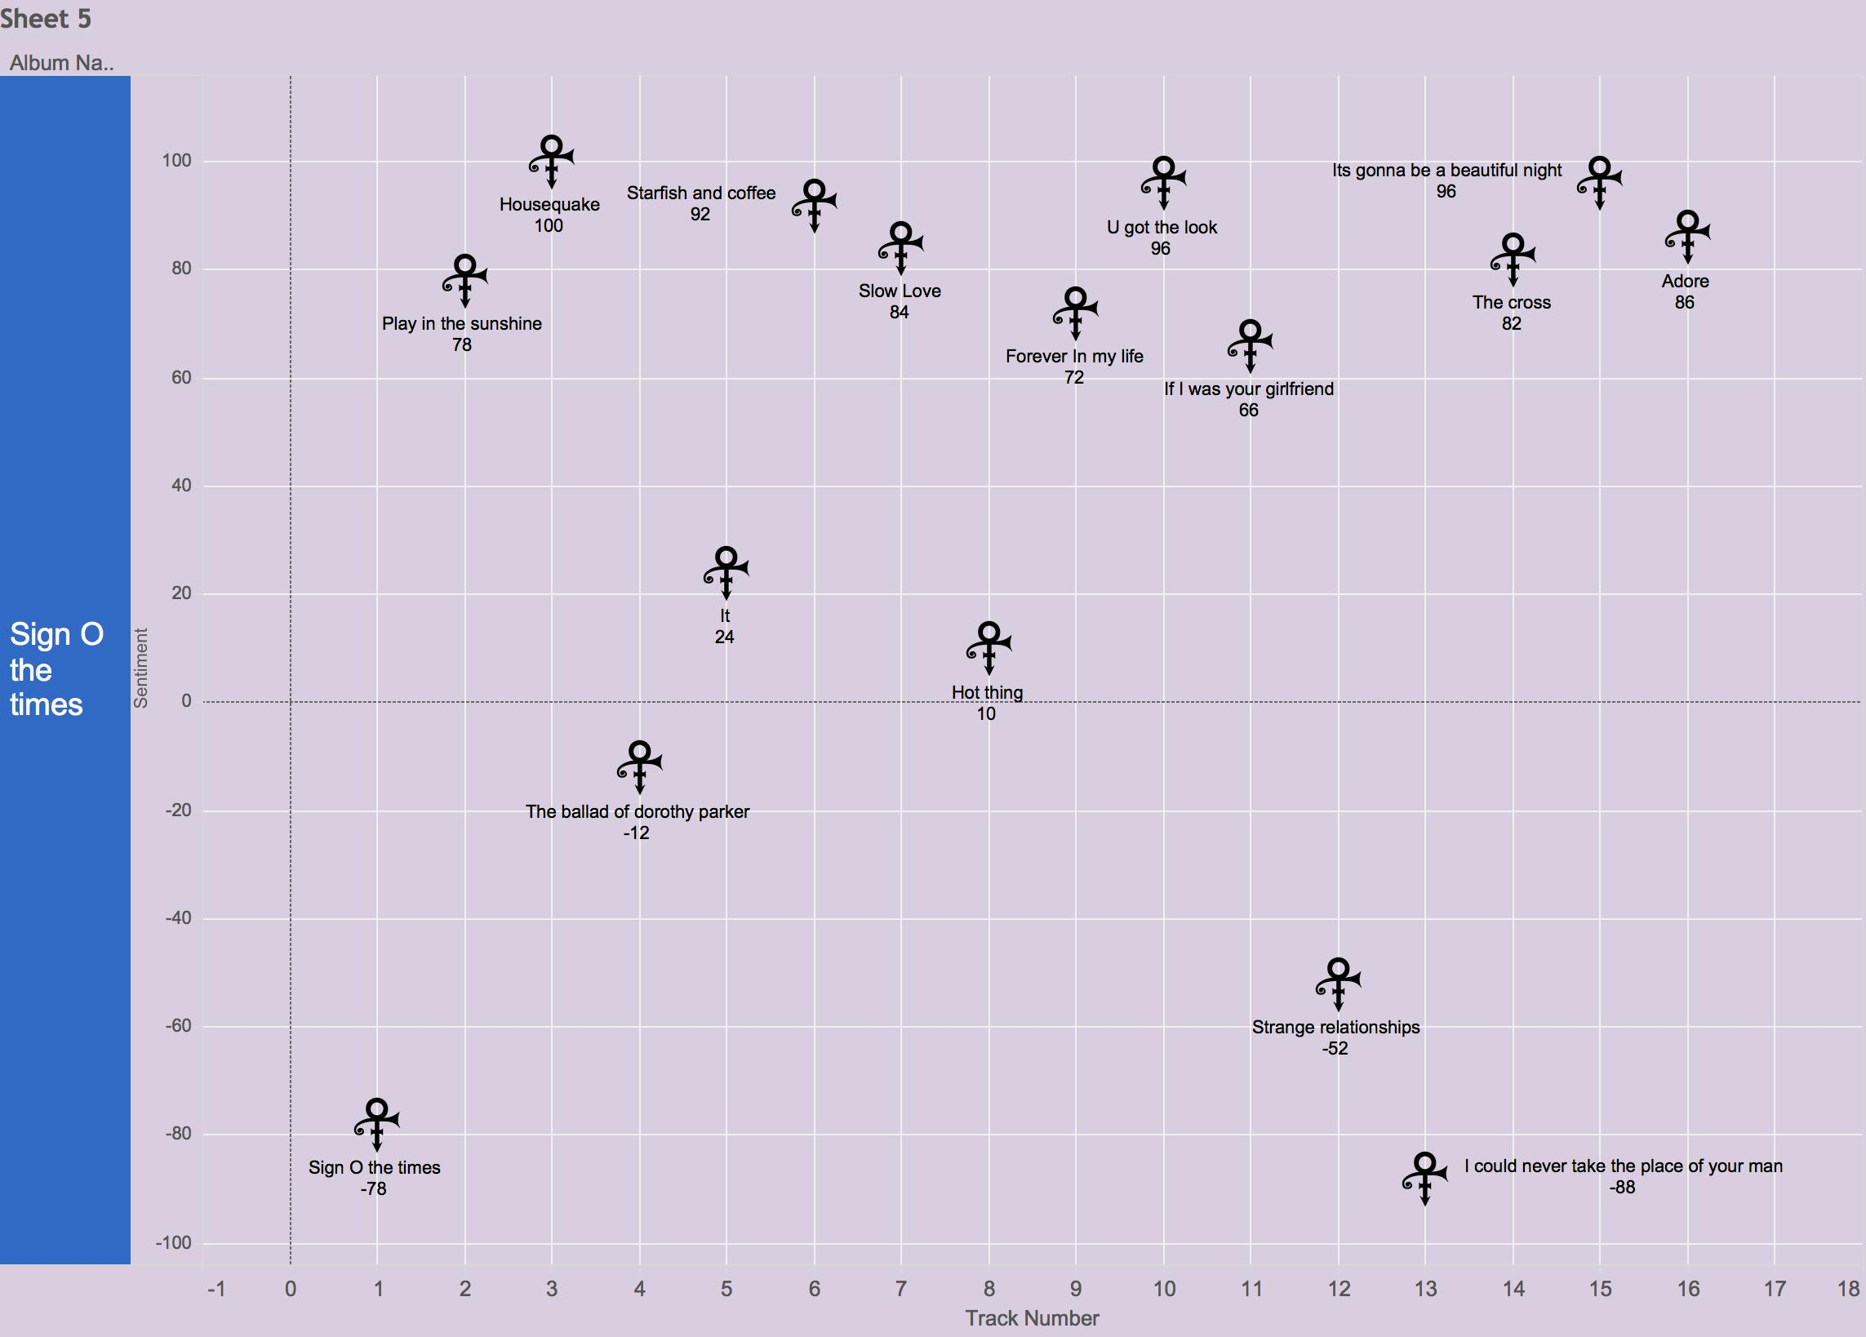
Sentiment by Track – Around the World In a Day, Parade, Sign o the Times

Slide 14
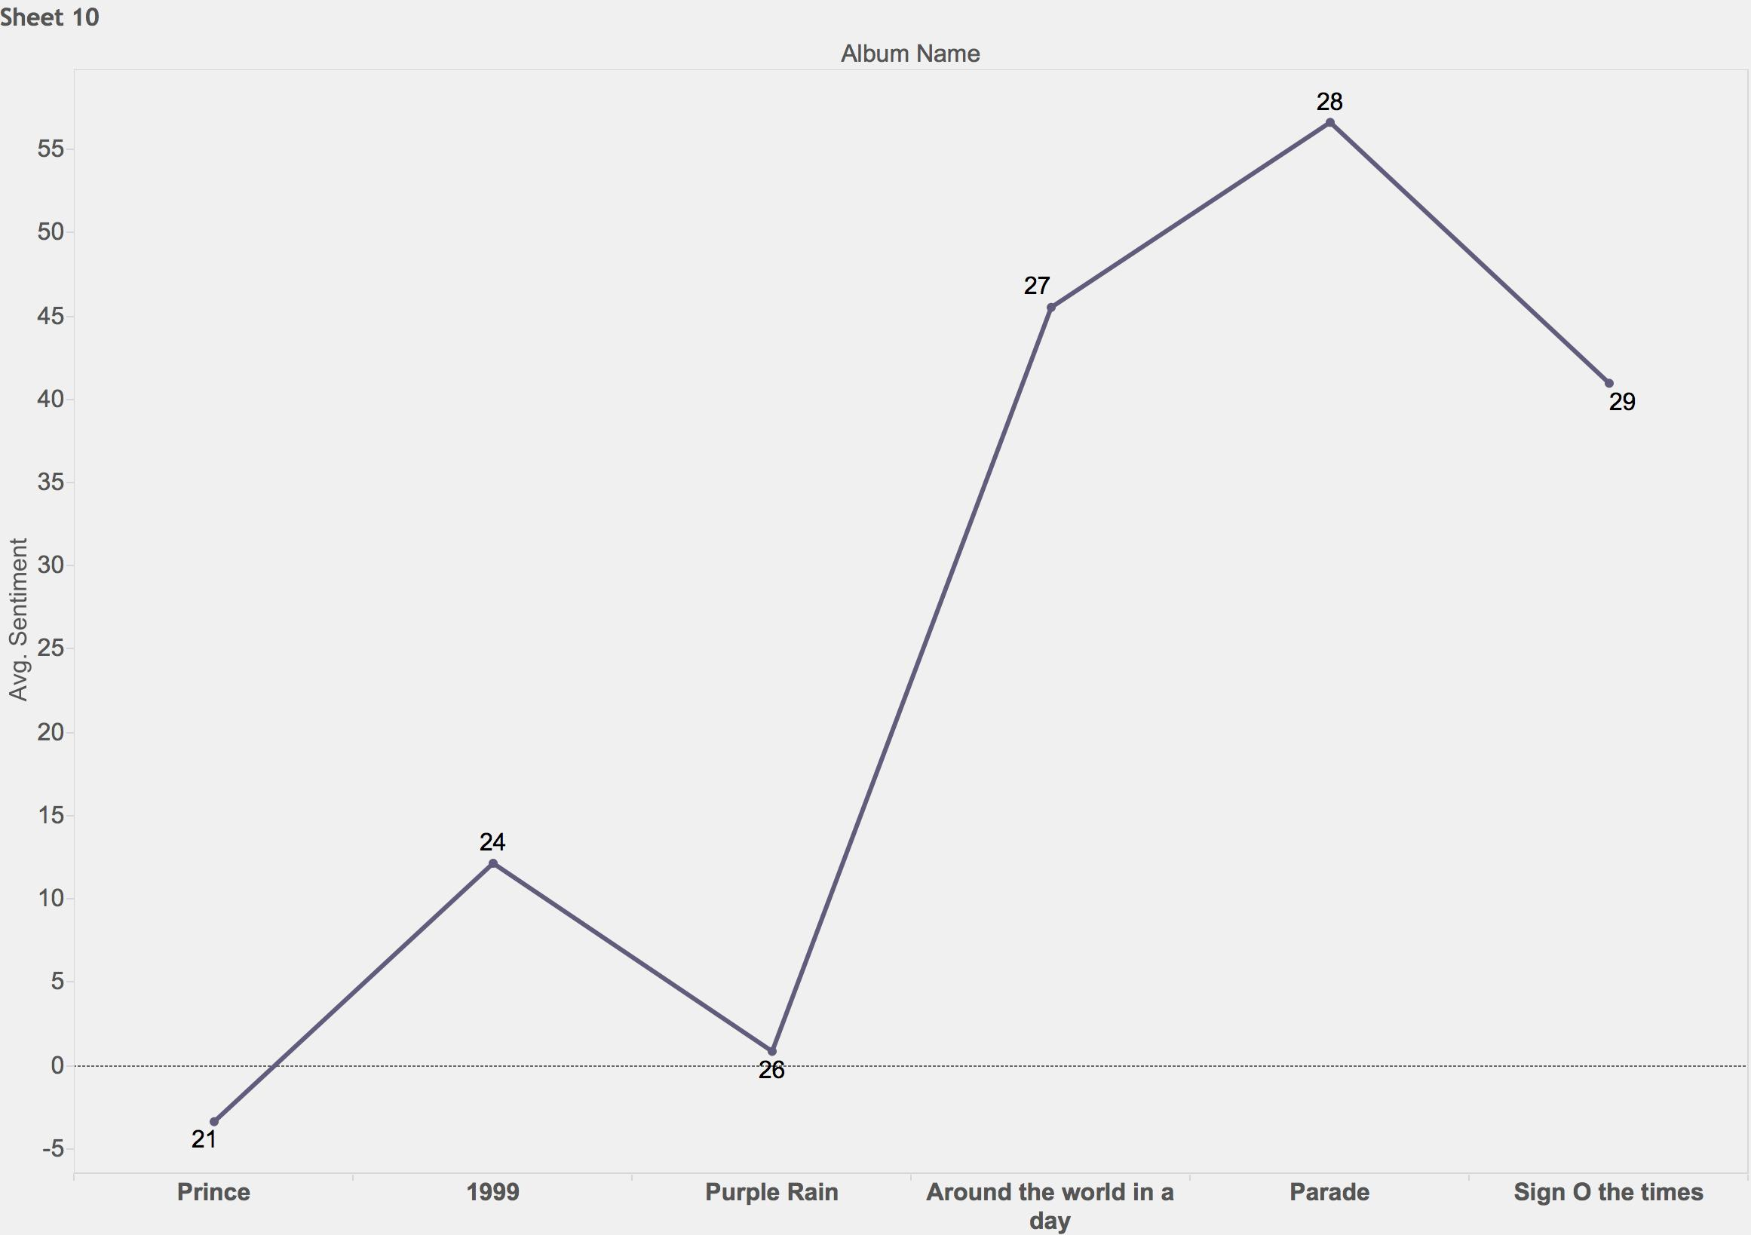
Average Sentiment by Album

Slide 15
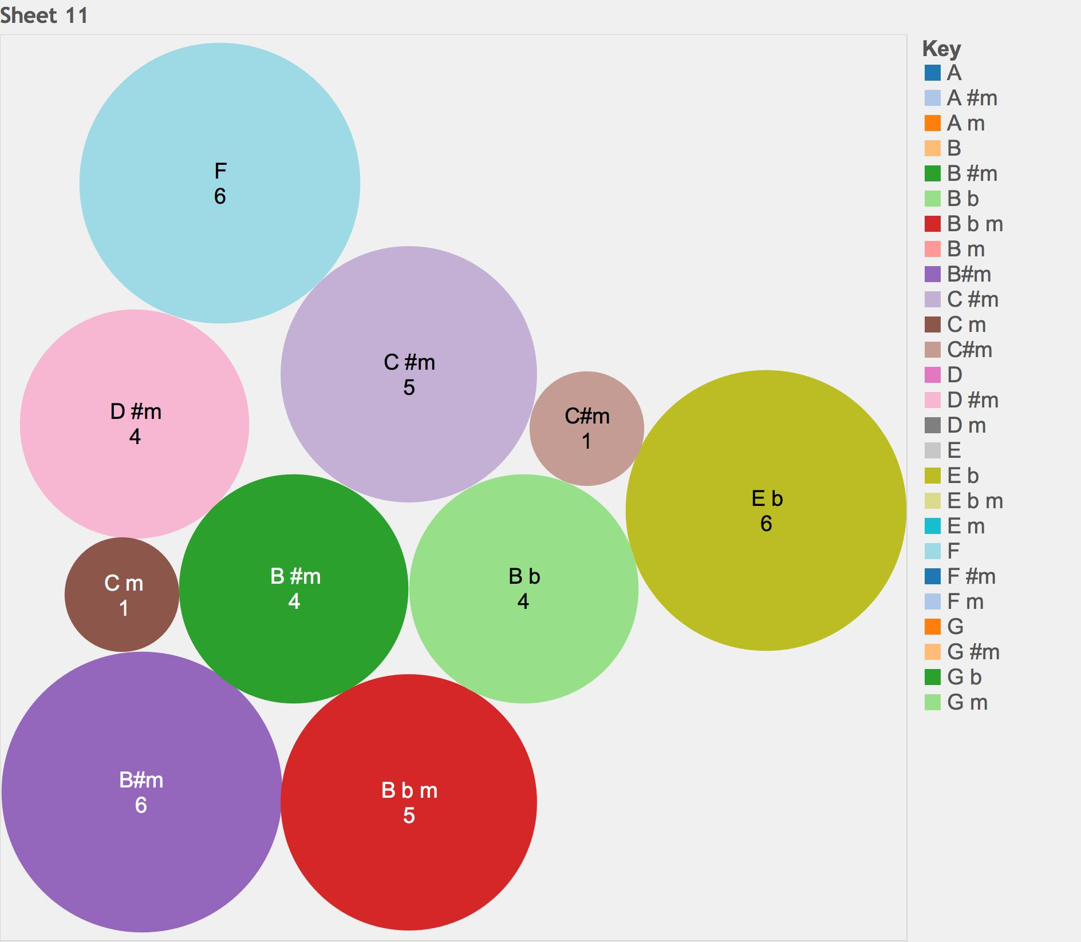
Song Key by Track Number

Slide 16
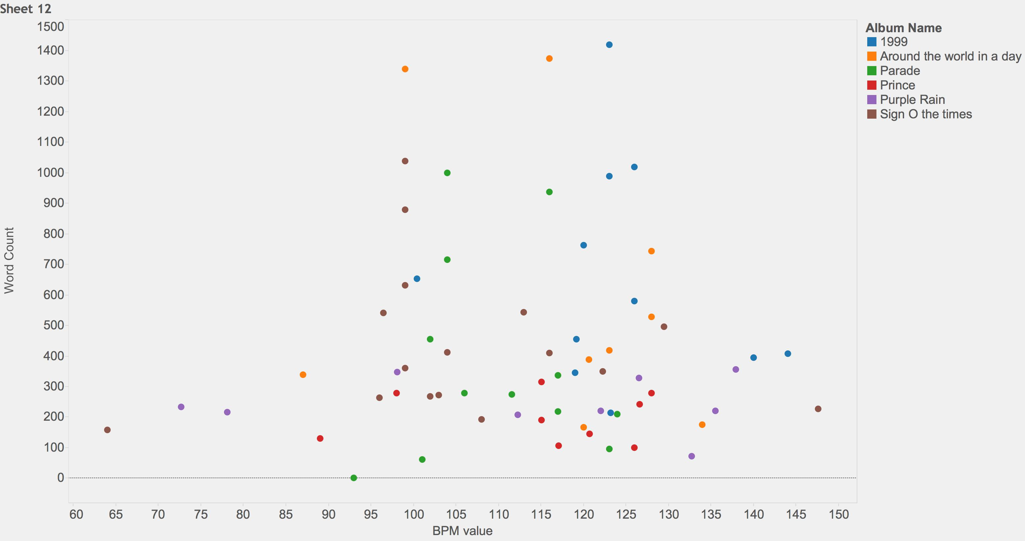
BPM and Word Count

Slide 17
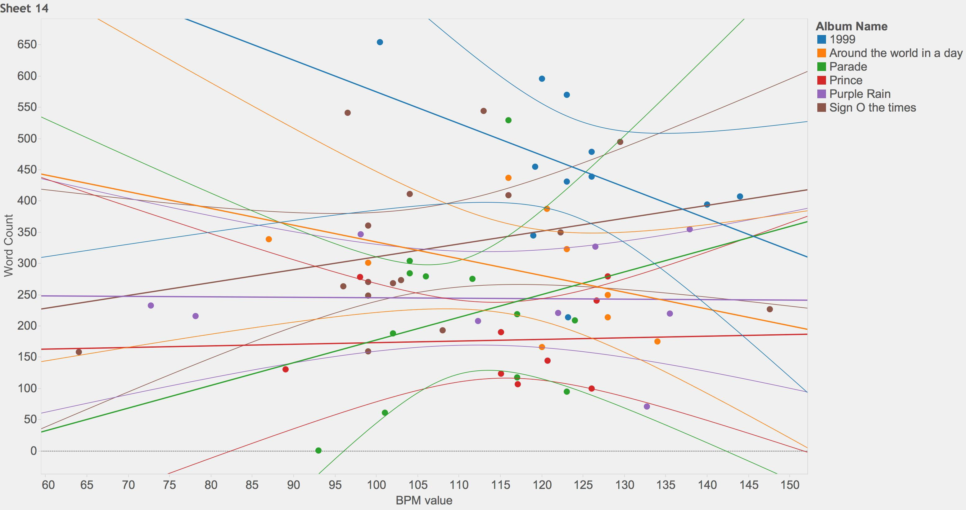
BPM and Word Count – Trend Lines

Slide 18
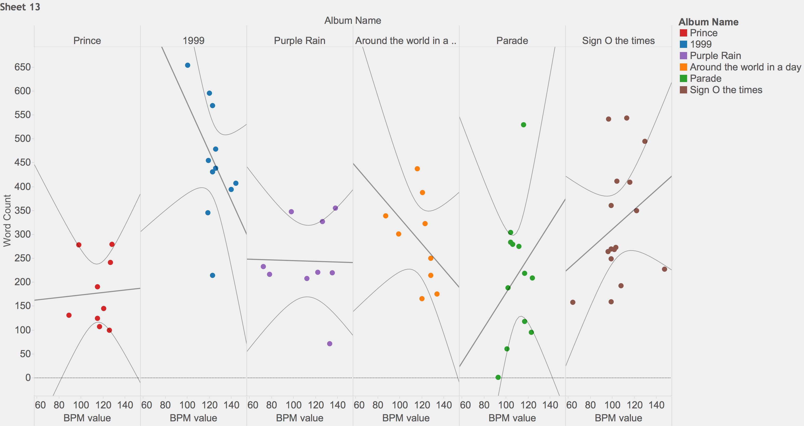
BPM and Word Count by Album with Trend Lines

Slide 19
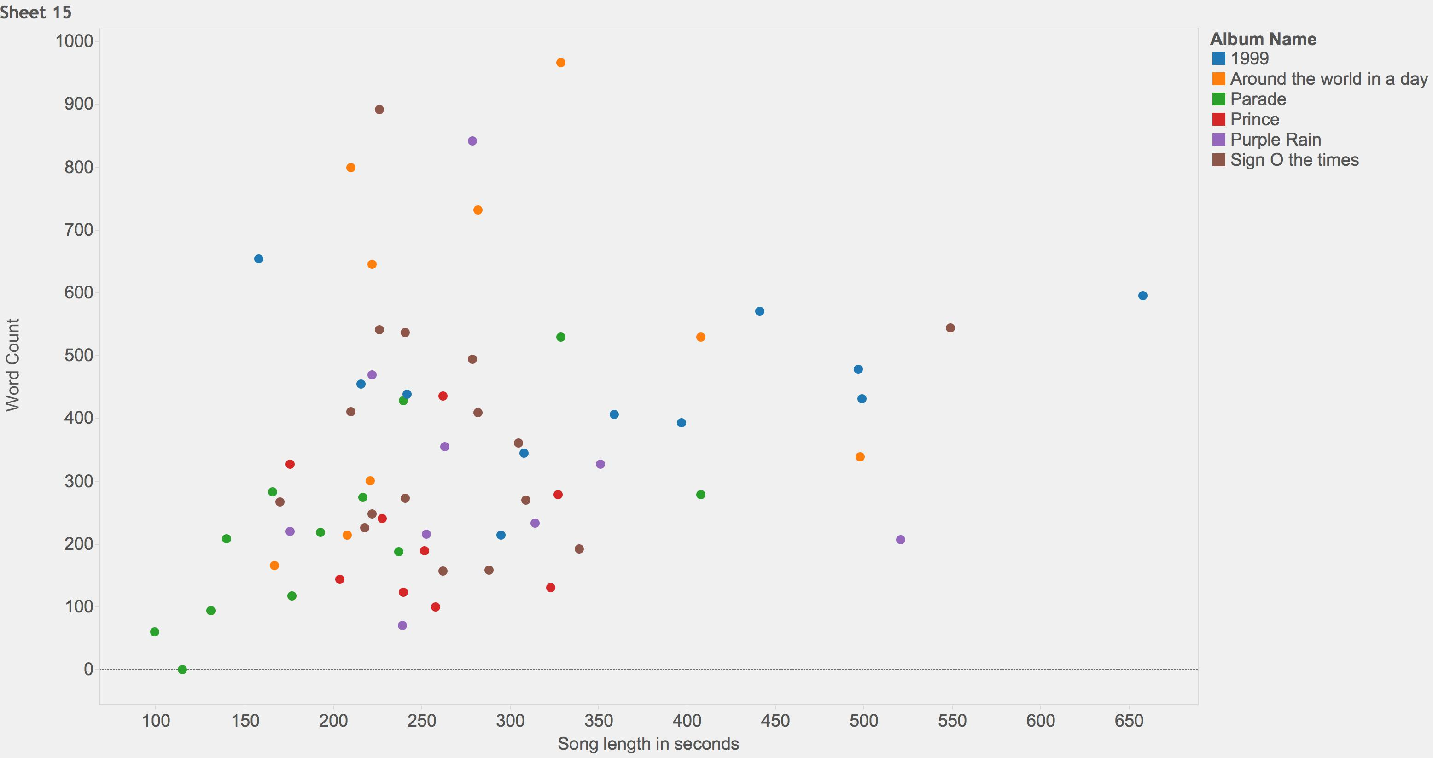
Song Length and Word Count

Slide 20
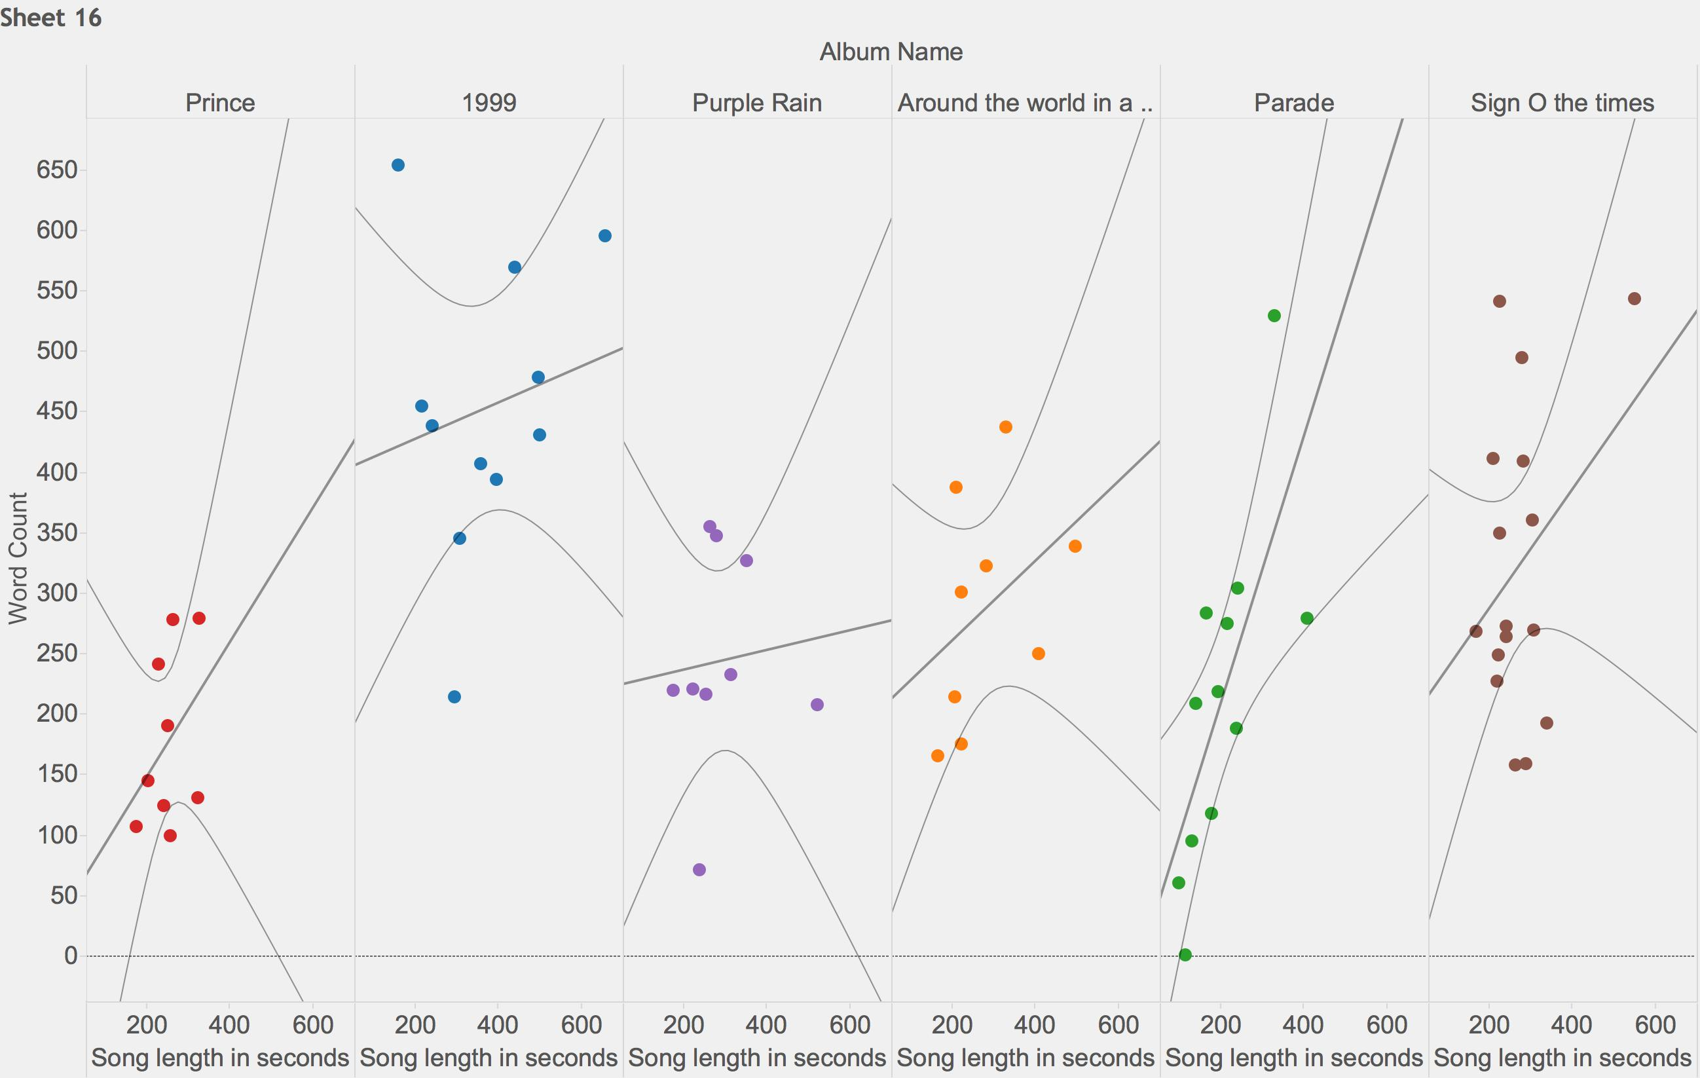
Song Length and Word Count by Album with Trend Lines

Slide 21
Models
Linear and Logistic Regressions Performed.
Very few strong correlations, mostly with song key and song structure, nothing correlated with if the song was a hit or not.
Modeled a few other artists quickly (Wiz Khalifa, Taylor Swift) and found stronger correlations. The models do work.
Maybe another way to determine…

Slide 22
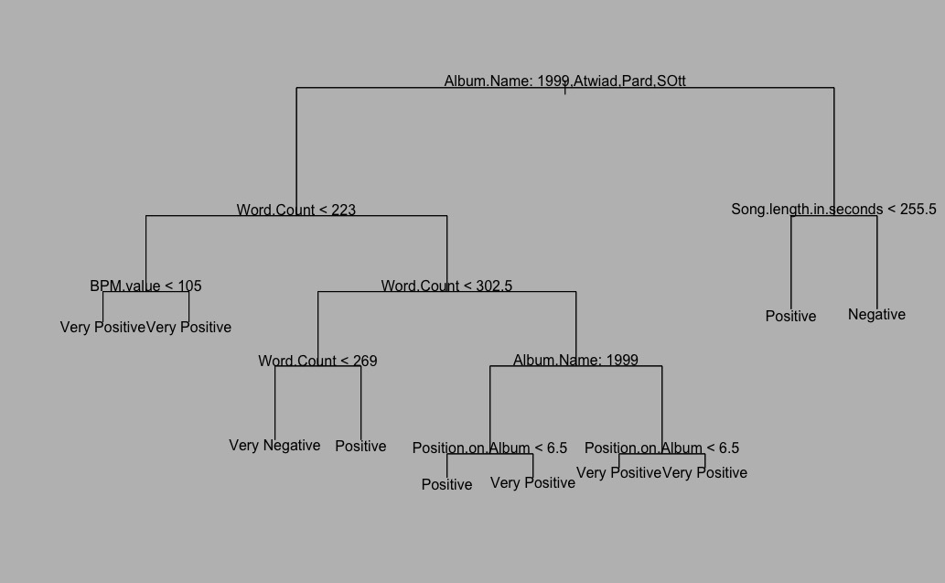
Decision Tree

Slide 23
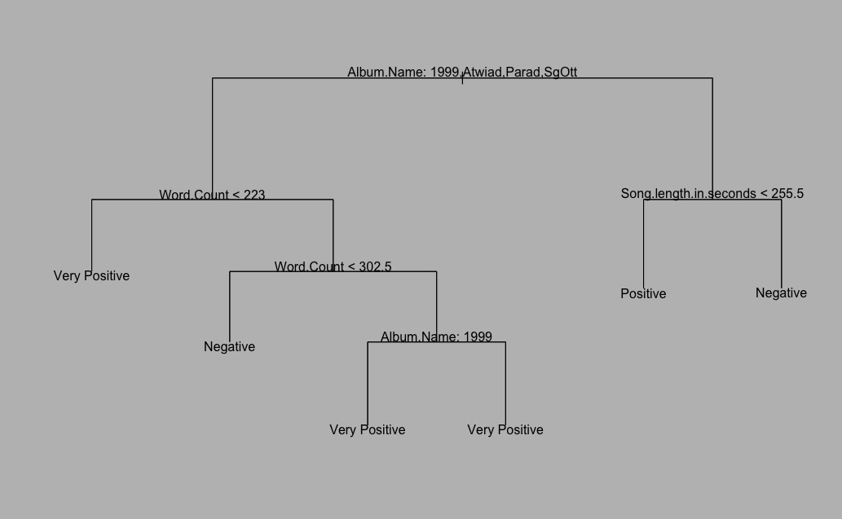
Pruned Tree

Slide 24
The Findings
There are relationships in album structure or song structure, but nothing that can predict if his song would be a hit.
There is some structure to his albums as regards song length with a preference to increase song length as the album progresses.
Tracks 4 and 9 are his preferred neutral sentiment track. Track 9 on Purple Rain, “Purple Rain” is a perfectly neutral sentiment song.
Not a lot of descriptive steps necessary to classify his songs as a hit categorization.

